Slide 1
User Interface(UI), User Experience(UX) and Wireframes

Slide 2
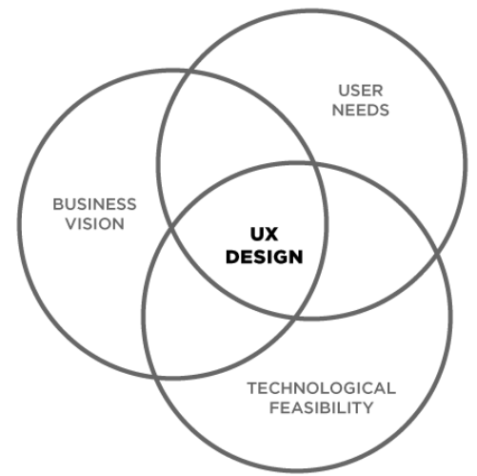
UI/UX Basics
What is UX?
UX stands for user experience or user experience design. It’s also sometimes abbreviated as UXD,UED or XD.
UX is the naked experience of a product: how a product functions, not how it looks.
UX Design is the process of enhancing user satisfaction of a product through increased usability, accessibility, and pleasure provided in the interaction with the product.

Slide 3
UI/UX Basics
What is UX?
User experience design encompasses note only traditional human–computer interaction design, but also all aspects of a product or service as perceived by users.
UX design is the merger of user needs, business vision and technological feasibility.
The result of UX design is a set of low-resolution wireframes (a basic visual guide for how a product will function) that are deeply connected with user research

Slide 4
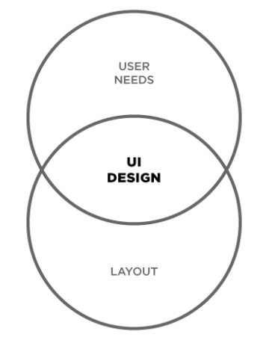
UI/UX Basics
What is UI?
UI stands for User Interface or User Interface Design. It’s also sometimes known as user interface engineering.
UI is the design of user interfaces for machines: how a product looks and feels, not how it functions.
UI Design is the process of making the user's interaction as simple and efficient as possible, in terms of accomplishing their goals (also known as user-centered design).

Slide 5
UI/UX Basics
What is UI?
UI design is the merger of user needs and visual design
The result of UI design is a set of high-resolution wireframes (a visual representation of a product).

Slide 6
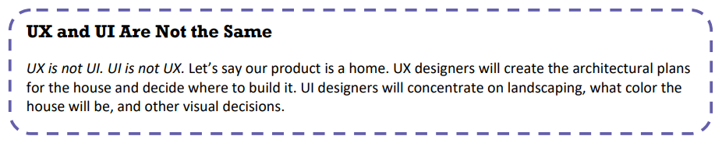
UI/UX Basics

Slide 7
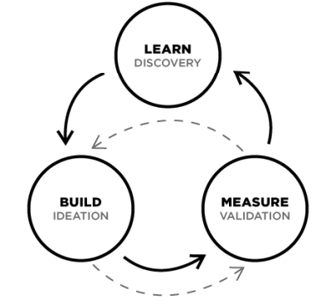
UI/UX Basics
What is the process of UX?
UX has 3 key phases:
Discovery
Ideation
Validation
However, UX design is cyclical, and you will often need to repeat certain steps and even the entire process multiple times.

Slide 8
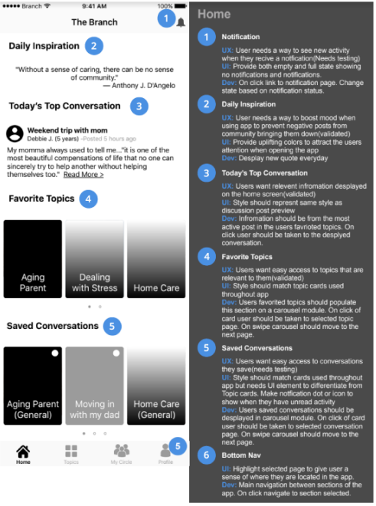
UI/UX Basics
What is the process of UX?
The final outcome will be a set of low-resolution wireframes: a draft of the function and structure of a product.

Slide 9
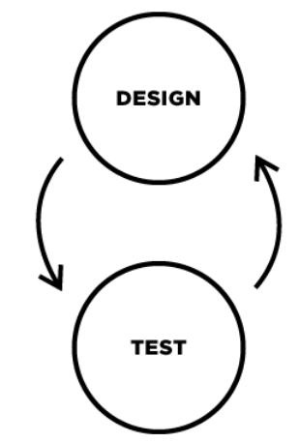
UI/UX Basics
What is the process of UI?
UI has 2 key phases:
Design
Testing
UI design precedes the development of the product's functional elements.

Slide 10
UI/UX Basics
What is the process of UI?
UI design is the creation of the finished interface
Focus is on the visual and emotional feel of the product.
UI design establishes the layout, colors, typography and interactivity to visually communicate the flow of the screens in an intuitive manner.
UI design process must balance technical functionality and visual elements to create a system that is not only operational but also usable and adaptable to changing user needs.

Slide 11
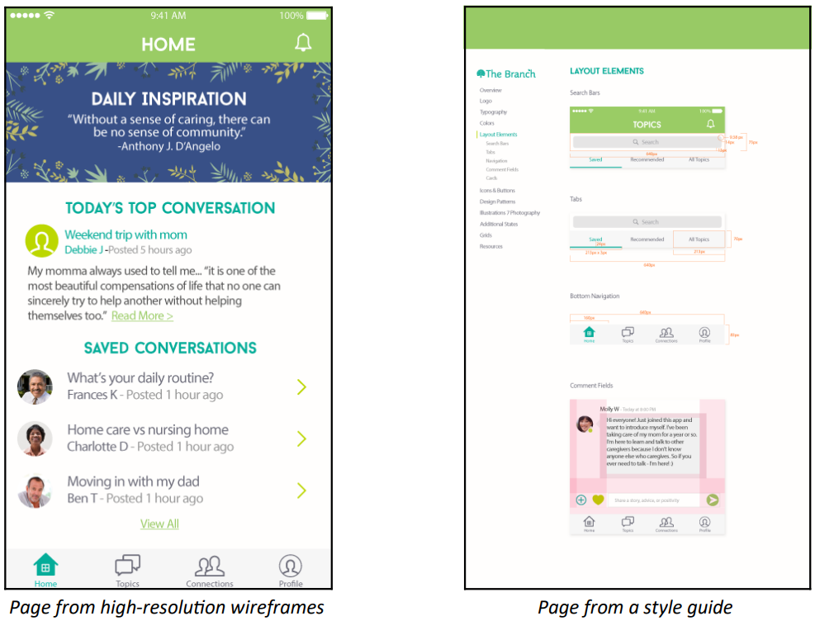
UI/UX Basics
What is the process of UI?
The final outcome will be a set of high-fidelity wireframes (a prototype or draft version of a product) and a style guide.

Slide 12
UI/UX Basics
How Do UI and UX Fit Together?
UI design is the creation of the finished interface
Focus is on the visual and emotional feel of the product.
UI design establishes the layout, colors, typography and interactivity to visually communicate the flow of the screens in an intuitive manner.
UI design process must balance technical functionality and visual elements to create a system that is not only operational but also usable and adaptable to changing user needs.

Slide 13
Understanding Wireframes
A wireframe is a visual representation of a user interface used to plan the layout and functionality of a website or mobile application.
They outline the structure and functionality of your product without getting caught up in colors, visuals, or specific content.

Slide 14
Understanding Wireframes
Purpose:
Visualize the layout and structure of a page or screen.
Determine placement of content and interactive elements.
Facilitate early-stage feedback and iterations.

Slide 15
Understanding Wireframes
Types:
Low-Fidelity: Simple sketches focusing on layout and content hierarchy.
High-Fidelity: Detailed designs incorporating exact dimensions and annotations.

Slide 16
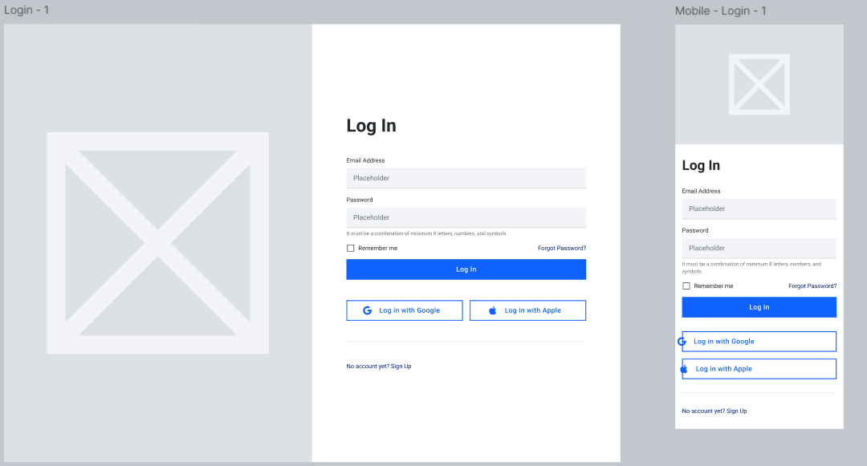
Understanding Wireframes Lo-fi wireframe example(login page)

Slide 17
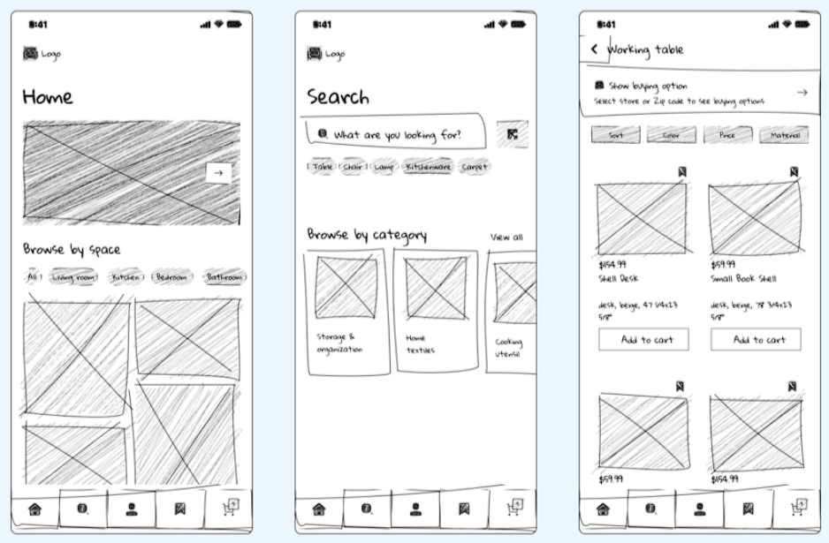
Understanding Wireframes Lo-fi wireframe example(e-commerce app)

Slide 18
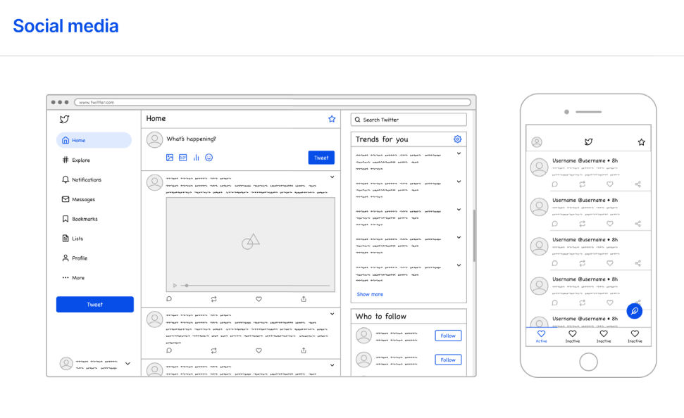
Understanding Wireframes Lo-fi wireframe example(social media)

Slide 19
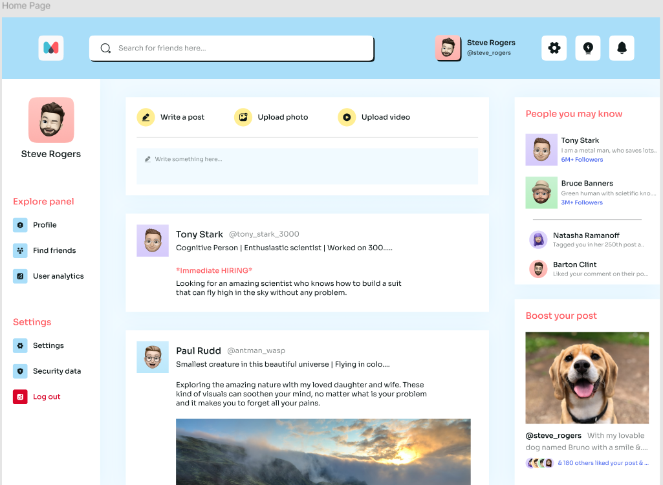
Understanding Wireframes Hi-fi wireframe example(social media)

Slide 20
Key Components of Wireframes
Information Design: Presentation of content to facilitate understanding.
Navigation Design: Elements that allow users to move through the interface.
Interface Design: Selection and arrangement of interactive components.

Slide 21
Wireframing Best Practices
Iterate Frequently: Regularly refine based on feedback.
Identify your design goals.
Choose the right size for your wireframe.
standard wireframe sizes for screen types are as follows:
Mobile: 393 pixels wide by 852 pixels tall
11” Tablet: 834 pixels wide by 1194 pixels tall
Desktop: 1440 pixels wide by 1024 pixels tall

Slide 22
Wireframing Best Practices
Iterate Frequently: Regularly refine based on feedback.
Keep your wireframe design simple
Start your wireframe using grayscale colors, limiting fonts, and replacing graphics with boxes.
Make sure your blueprint meets the user requirements at the most basic level.

Slide 23
Wireframing Best Practices
Iterate Frequently: Regularly refine based on feedback.
Maintain design consistency.
Similar components should look the same across all wireframes, so they're easy to grasp, iterate on, and code.
Even if there’s a slight variation between two related components, different designs can create uncertainty for developers across pages and iterations.

Slide 24
Wireframing Best Practices
Iterate Frequently: Regularly refine based on feedback.
Make navigation obvious.
Your user flows should be fluid and intuitive.
As you apply information architecture to your wireframe, consider where you might need to support it with navigation and wayfinding cues.

Slide 25
Wireframing Best Practices
Iterate Frequently: Regularly refine based on feedback.
Don’t get too attached to your wireframe.
Even a high-fidelity wireframe is still a rough draft that needs changes to become a final product.
Once your design team finalizes the wireframe design, it’s time for collaboration with developers and other creative team members to add functionality.

Slide 26
Wireframing Best Practices
Iterate Frequently: Regularly refine based on feedback.
Leverage wireframing tools
Design teams need wireframes they can share, save, and turn into mockups online.
Figma's wireframe kit comes with drag-and-drop design tools that make it easy for beginners and design pros alike to create customized, high-fidelity wireframes.

Slide 27
Tools for Wireframing
Iterate Frequently: Regularly refine based on feedback.
Pen and Paper: Ideal for quick sketches and brainstorming.
Digital Tools: Software like Figma, Sketch, or Adobe XD offers advanced features for detailed wireframes.

Slide 28
Figma Tool Demonstration for Wireframing
Iterate Frequently: Regularly refine based on feedback.

Slide 29
Benefits of Wireframing
Iterate Frequently: Regularly refine based on feedback.
Early Detection of Issues: Identify design flaws before development.
Improved Communication: Align team members and stakeholders on design vision.
Cost-Effective: Making changes at the wireframe stage is less costly than post-development.

Slide 30
References
Iterate Frequently: Regularly refine based on feedback.
https://elmhurstpubliclibrary.org/lib/wp-content/uploads/UIUXBasics_Handout_021918jj.pdf
https://designcode.io/figma-handbook-ui-wireframe
https://www.visily.ai/blog/what-is-low-fidelity-wireframe/
https://www.figma.com/resource-library/what-is-wireframing/#when-to-skip-wireframe-stages

